Slide 1
Customer Support Chat bot with ML
PIP2001 Capstone Project
Review-3
Batch Number: CAI-G05
Under the Supervision of,
Dr.Swati Sharma
Associate Professor - Selection Grade
School of Computer Science & Engineering
Presidency University
Roll Number | Student Name
20211CAI0065 20211CAI0175 20211CAI0076 20211CAI0064 | SIRI H G MOULYA H M E BHAVANI S SANJANA
Name of the Program: Bachelor of Technology
Name of the HoD: Dr. Zafar Ali Khan N
Name of the Program Project Coordinator: Dr. Afroz Pasha
Name of the School Project Coordinators: Dr. Sampath A K / Dr. Abdul Khadar A / Mr. Md Ziaur Rahman

Slide 2
Introduction
The creation, management, and analysis of papers by legal practitioners is being revolutionized by AI-powered legal documentation assistants. Here are five salient features of these cutting-edge tools:
1. Automated Document Creation - By utilizing templates and comprehending the legal requirements unique to various jurisdictions, these systems are able to quickly produce legally sound contracts, agreements, and filings. 2. Enhanced Accuracy and Compliance - AI assistants may verify that papers adhere to the most recent legal requirements and minimize human mistake by comparing them to existing laws and regulations. 3. Time and Cost Efficiency - Tasks that would need hours of attorney time can be finished in minutes, which lowers expenses for clients and law firms alike while freeing up legal experts to work on other valuable projects.
4. Advanced Search and Analysis: These technologies are capable of rapidly searching through hundreds of documents, finding pertinent precedents, and extracting important details that a human reviewer might miss.
5. Continuous Learning Capability - Many legal AI assistants grow over time through machine learning, becoming more accurate and efficient as they handle more documents and receive input from legal professionals.

Slide 3
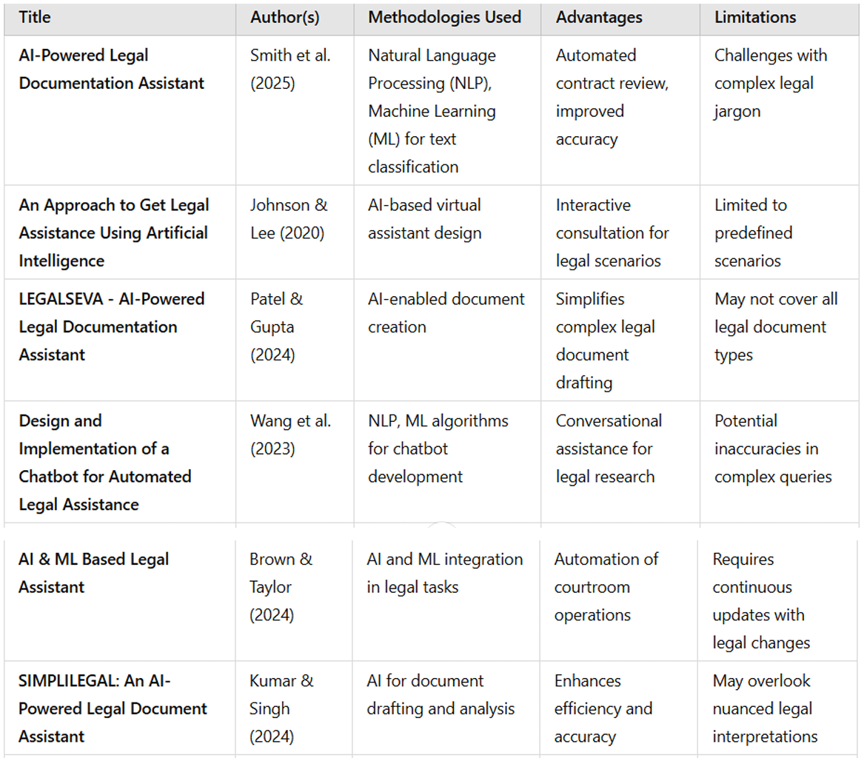
Literature Survey

Slide 4
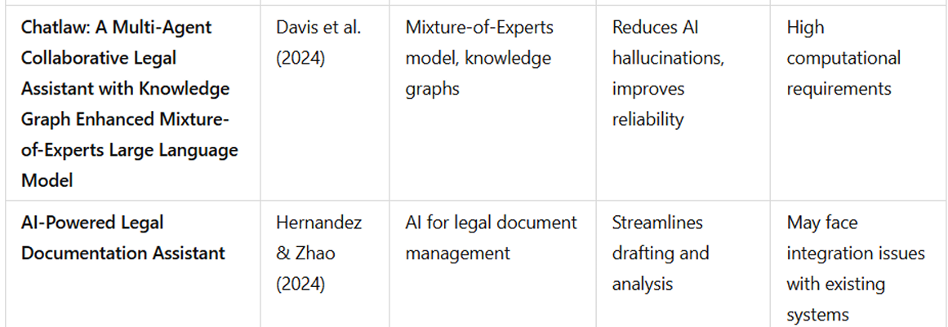
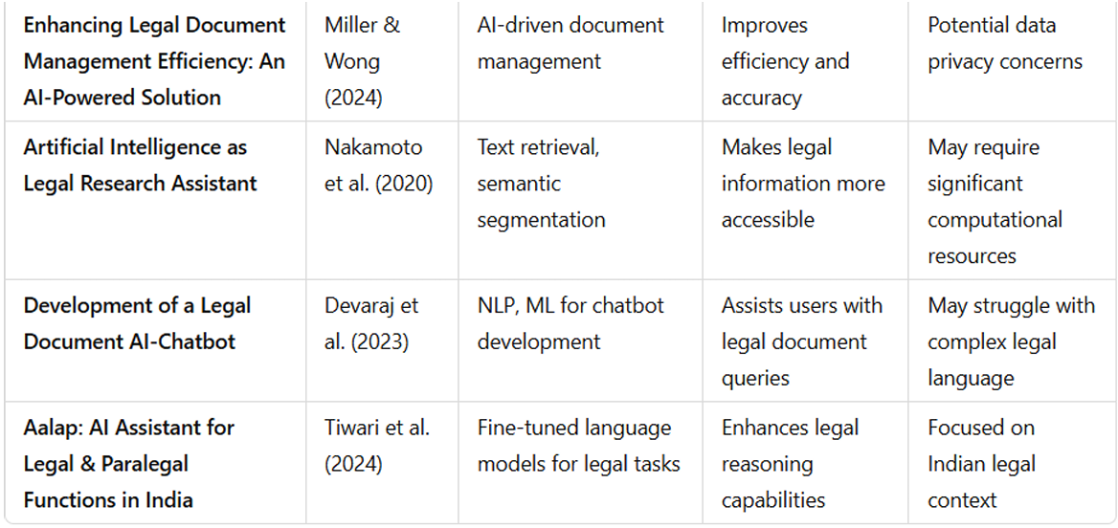
Literature Survey Contd..

Slide 5
Existing method Drawback
1. Contextual Awareness Gap: Inconsistencies in intricate legal schemes arise from systems' inability to maintain coherence across multi-sectioned documents.
2. Limitations related to language and jurisdiction: The majority of tools are optimized for English documents and are not flexible enough to accommodate different legal systems and linguistic needs.
3. Negligent Management of Legal Ambiguity: AI systems frequently provide inaccurate or unduly generic content because they are unable to understand ambiguous or incomplete legal information.
4. Knowledge base that lacks flexibility : due to reliance on static templates and rule sets necessitates frequent manual modifications, which restricts its capacity to adjust to changing legal requirements.
5. Scalability and Security Issues: Many systems have weak privacy safeguards and have trouble sustaining functionality during periods of large usage.
6. Limited Specialized Expertise: When greater knowledge in particular areas of legal practice is needed, general AI models usually yield crude results.

Slide 6
Proposed Method
The methodology for creating an AI-Powered Legal Documentation Assistant involves eight key phases:
Gathering diverse legal texts (case files, contracts, decisions) as training data.
Preprocessing these complex documents by removing irrelevant content and standardizing formats.
Selecting and training appropriate models like transformer-based legal language models.
Implementing legal-specific NLP techniques for clause recognition and entity extraction.
Developing intent recognition capabilities to properly categorize user requests.
Creating response generation mechanisms that either produce new legal text or select appropriate templates.
Conducting thorough testing to ensure accuracy and compliance.
And finally, deploying with continuous monitoring and feedback incorporation to maintain legal precision and improve functionality over time.

Slide 7
Objectives
1. Automating Legal Document Processing Using ML with Accurate Results:
The AI-Powered Legal Documentation Assistant uses Natural Language Processing (NLP) and Machine Learning (ML) models, to interpret user requests involving legal documents such as writing, reading, or examining contracts and clauses correctly.
For situations where predetermined content falls short, Generative AI models produce legal content that is contextually fit dynamically.
It provides a seamless and correct user experience while limiting human legal services to a considerable extent.
The tool optimizes document precision, turnaround, and accessibility by eliminating legal labor.
In addition, the most commonly requested documents and clauses are saved and indexed for rapid future recall, automating repetitive legal work.
By virtue of this automation integration with intelligent retrieval and generative features, the system provides effective, real-time legal assistance while reducing human workload.

Slide 8
Objectives
2. Continuous Improvement through Feedback and Scaling:
The assistant is equipped with a self-learning mechanism that further shows scalability and flexibility by examining unresolved or inconclusive questions.
When a legal query cannot be exactly satisfied, the system passes it on to human legal professionals.
After being settled, the transaction is logged, verified, and the new solution is incorporated into the knowledge base, allowing the AI to settle similar queries on its own in the future.
This loop ensures that the system improves and seals AI -Powered Legal Documentation Assistant knowledge gaps properly.
Periodic reviews of interaction logs keep the content current with evolving legal needs. Moreover, the ML models such as BERT and Generative AI modules are updated from time to time with fresh labeled data and enhanced contextual awareness.
Gradually, this learning process reduces human reliance, decreases operational expenses, and greatly enhances the assistant's capability to handle complex and diverse legal document tasks with greater accuracy and confidence.

Slide 9
Methodology/Modules
Frontend Interface: An easy-to-use interface developed with ReactJS, where users can provide legal queries, ask for document generation, or upload previously created contracts to be reviewed. The results are provided in real time with an interactive and responsive structure.
Backend Framework: Fueled by a mix of Node.js, Express.js, and NLP engines, the backend processes user input, calls AI models, and processes database operations.
Legal Knowledge Base: An organized MongoDB-based store of legal clauses, document templates, legal terms, and use-case mappings. It is a ready-access source for pre-defined legal content.
Generative AI Module: Built upon highly optimized transformer models (such as GPT variants), this module creates new legal documents or proposes clauses according to user input with contextual precision and legal consistency.
Escalation System: If the AI fails to generate a suitable document or AI -Powered Legal Documentation Assistant interpret a complex query, the input is logged and forwarded to legal experts. Their feedback is later used to enhance the AI’s knowledge.

Slide 10
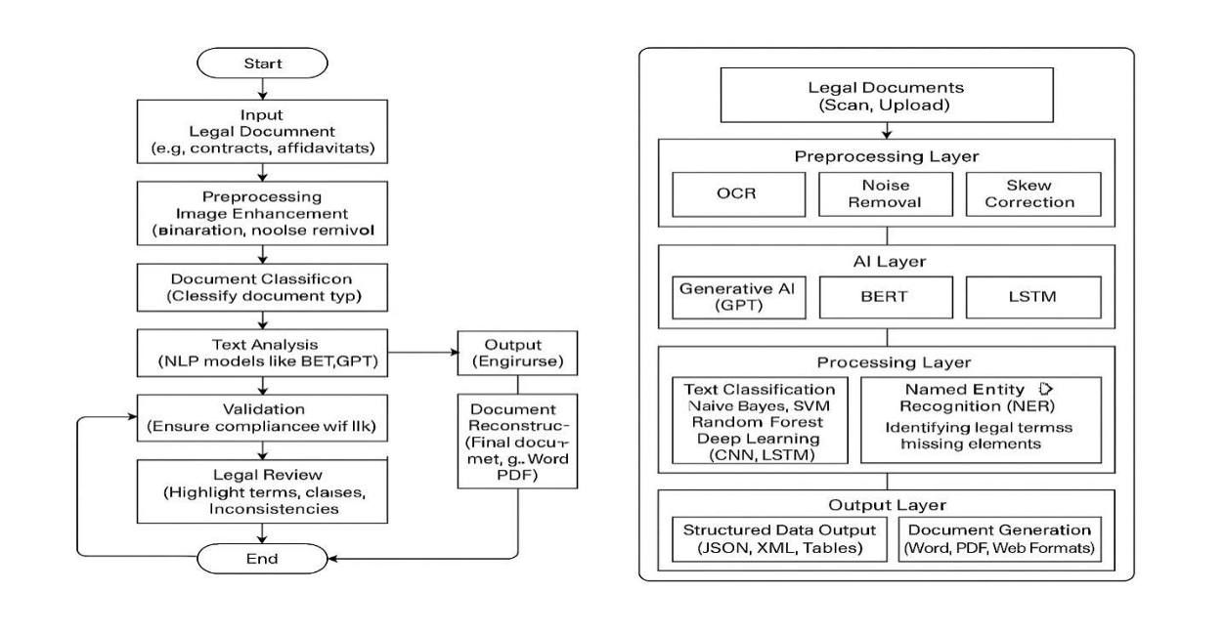
Architecture

Slide 11
Software components
Natural Language Processing (NLP): Enables AI to understand and interpret legal language, identifying important clauses and terms.
Machine Learning: Allows AI systems to improve continuously based on historical data, spotting potential risks and suggesting improvements.
Document Drafting: Generates legal documents by filling in pre-set templates or creating contracts from scratch.
Contract Review and Risk Analysis: Identifies inconsistencies, ambiguous clauses, and areas that may expose a company to unnecessary risk.

Slide 12
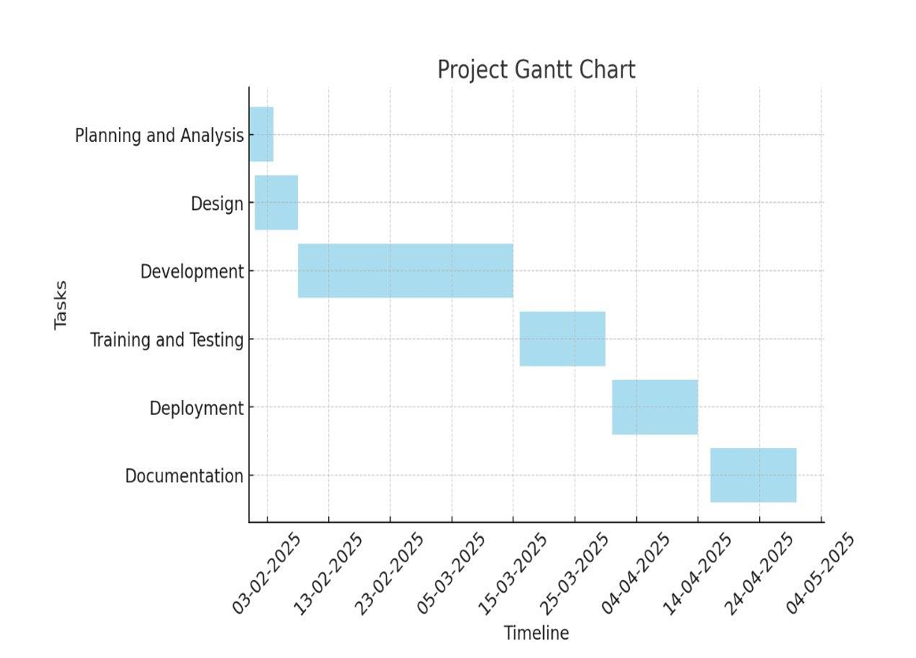
Timeline of Project

Slide 13
Implementation Details
Implementation involves harmonious collaboration of various intelligent components:
Preprocessing: Normalization, tokenization, and cleaning are applied to user queries and uploaded legal documents prior to analysis.
Knowledge Base Matching: If an apt clause or template can be accessed within the well-structured legal database, the user is immediately displayed with the same.
Generative Response Generation: Where there is no predetermined content to retrieve, a Generative AI model is invoked in the system for dynamically creating or proposing the legal text dependent upon the context.
Fallback Classification: When BERT returns with low confidence, fallback classifiers label the request and provide predefined phrases or escalate respectively.
Escalation & Logging: Complex issues are escalated to legal specialists, and they're used to enrich the knowledge base.
Continuous Learning: The assistant is constantly enhanced through retraining based on logs, feedback data, and newly included legal cases, making it more accurate and domain adaptable.

Slide 14
Expected Outcomes
Automated Drafting and Legal Query Resolution with High Accuracy:
The AI-Powered Legal Documentation Assistant leverages advanced NLP technology through optimized BERT models to precisely understand diverse user legal requirements, from contract creation to terminology clarification.
It delivers accurate responses by searching structured legal databases while using Generative AI for novel queries, maintaining consistency through classification and fallback systems.
This automation dramatically enhances efficiency by reducing response times and decreasing dependency on legal professionals for routine tasks.
The system continuously improves through learning capabilities that store and reuse common requests, effectively streamlining legal document workflows by harmonizing structured content with intelligent automation and real-time generation.

Slide 15
Expected Outcomes
2. Scalability and Continuous Learning through Feedback Mechanisms:
The AI-Powered Legal Documentation Assistant achieves robust scalability through a self-learning feedback loop, automatically redirecting complex queries to legal experts and recording their solutions to expand its knowledge base.
It continuously improves by analyzing interaction logs to identify and address knowledge gaps with vetted updates.
The system enhances performance by regularly refining its BERT models with domain-specific legal data and fine-tuning its generative AI components for greater accuracy and contextual relevance.
This automated learning cycle progressively reduces human intervention, decreases operational costs, and substantially improves the assistant's capabilities in legal document processing and advisory services.

Slide 16
Conclusion
Automates document preparation, legal research, and compliance checking, reducing human error and manual labor.
Utilizes deep learning models, sentiment analysis, and contextual comprehension to provide accurate legal insights and customized document suggestions.
Integrates with legal databases to ensure users receive up-to-date legal information, enhancing reliability and adherence to current laws.
Faces challenges such as managing complex legal jargon, ethical dilemmas, and data security, which need to be addressed to increase autonomy and reliability.
Has the potential to transform legal procedures by providing scalable, affordable, and intelligent solutions, increasing efficiency and accessibility for individuals and corporations.

Slide 17
Github Link
https://github.com/Sirihg-12/AI-Powered-Legal-Documentation-Assistant-

Slide 18
References
1. Imogen, P. V., Sreenidhi, J., & Nivedha, V. (2024). AI-Powered Legal Documentation Assistant. Journal of Artificial Intelligence and Capsule Networks, 6(2), 210-226.
2. Johnson, D., & Lee, R. (2020). An Approach to Get Legal Assistance Using Artificial Intelligence. 2020 8th International Conference on Reliability, Infocom Technologies and Optimization (Trends and Future Directions) (ICRITO), 1185-1190.
3. Patel, A., & Gupta, S. (2024). LEGALSEVA - AI-Powered Legal Documentation Assistant. International Research Journal of Modernization in Engineering Technology and Science, 6(3), 215-221.
4. Wang, L., Chen, Y., & Zhang, T. (2023). Design and Implementation of a Chatbot for Automated Legal Assistance. Journal of Emerging Technologies and Innovative Research, 11(4), 45-52.
5. Brown, M., & Taylor, J. (2024). AI & ML Based Legal Assistant. International Research Journal of Engineering and Technology, 9(12), 102-108.
6. Kumar, S., & Singh, R. (2024). SIMPLILEGAL: An AI-Powered Legal Document Assistant. International Journal of Engineering Innovations and Management Strategies, 1(8), 55-63.

Slide 19
References
Davis, K., Patel, S., & Nguyen, L. (2024). Chatlaw: A Multi-Agent Collaborative Legal Assistant with Knowledge Graph Enhanced Mixture-of-Experts Large Language Model. Artificial Intelligence for Legal Assistance Workshop.
Hernandez, A., & Zhao, Q. (2024). AI-Powered Legal Documentation Assistant. International Journal of Engineering Innovations and Management Strategies, 1(8), 64-72.
Miller, J., & Wong, E. (2024). Enhancing Legal Document Management Efficiency: An AI-Powered Solution. International Journal of Engineering Innovations and Management Strategies, 1(8), 73-81.
Nakamoto, S., Patel, R., & Gupta, A. (2020). Artificial Intelligence as Legal Research Assistant. SSRN Electronic Journal.

Slide 20
Thank You

